Slide 1
Options Trading Competition
Week 5

Slide 2
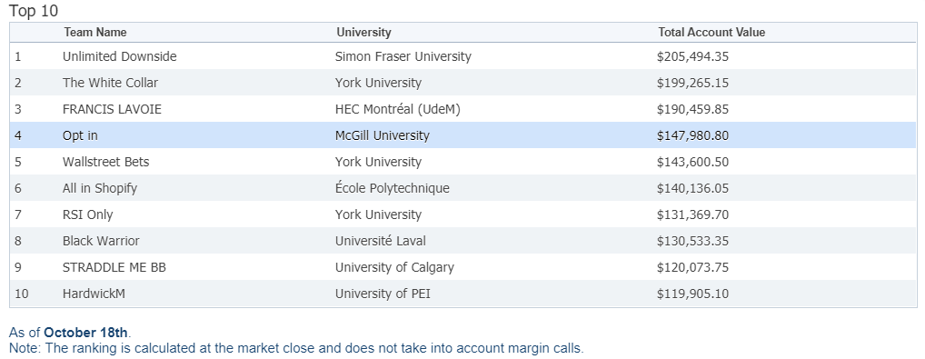
What Happened Last week:
We are now FOURTH in Canada!!!!
Closed SHOP, TD, RY, and ECA positions.
Opened (and closed) the following positions:
CVE Long Straddle
Teck.B Covered Call
ABX Collar

Slide 3
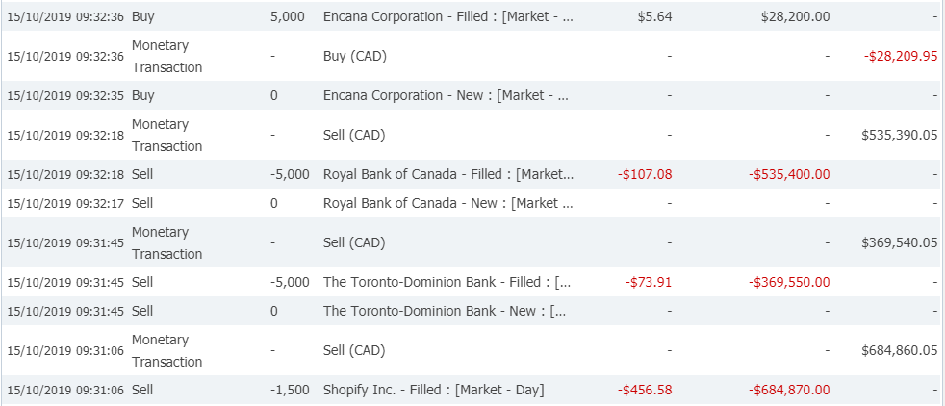
Refresher on OUR Positions from TWO WEEKS AGO:
Net Debits for each position:
ECA: -2659.95
SHOP: -45309.95
TD: -6059.95
RY: -6659.95
Cash Flow Upon Expiry:
ECA: +32500
SHOP: -600000
TD: -362500
RY: -522500
Cash Flow Upon Position Close:
ECA: -$28209.95
SHOP: +684860.05
TD: +369540.05
RY: +535390.05
Bottom Line:
ECA: + $1630.10
SHOP: + $39550.10
TD: + $980.01
RY: + $6230.10
= $48,390.31
Notes:
Talk about if these were good decisions.

Slide 4
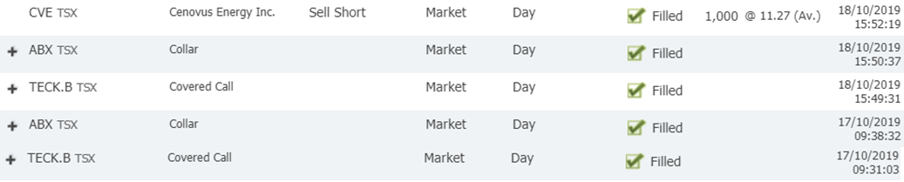
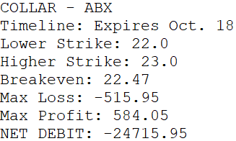
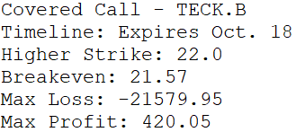
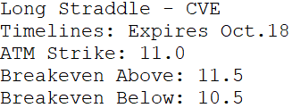
New positions last week:

Slide 5
New position Cash Flows:
Opening
CVE
TECK.B
ABX
Closing
CVE
TECK.B
ABX
Bottom Line:
CVE: - $239.90
TECK.B: - $39.90
ABX: + $38.15
= - $241.65

Slide 6

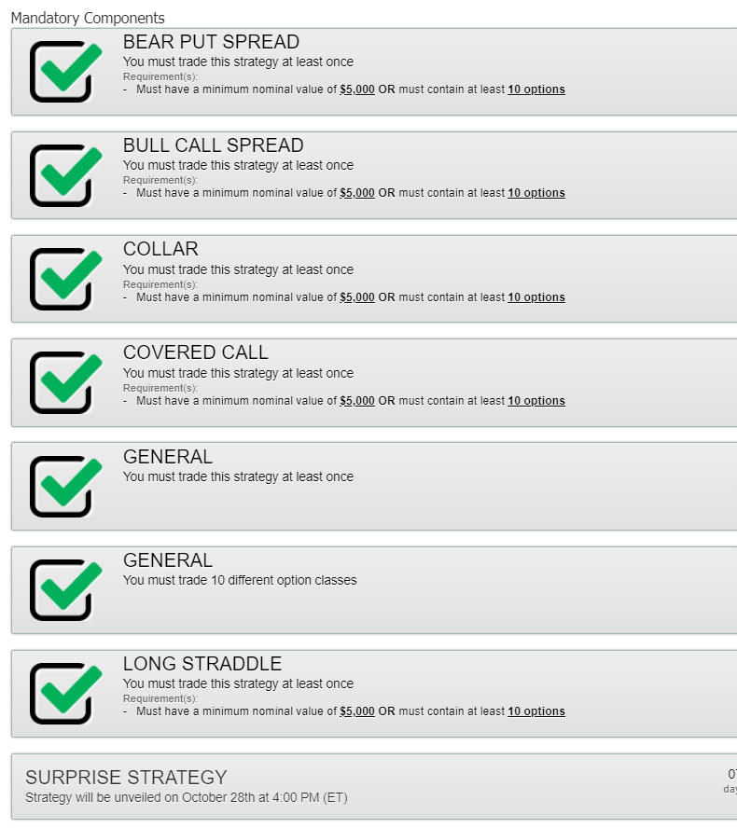

State of the mandatories
All mandatories complete
Waiting for surprise strat.

Slide 7
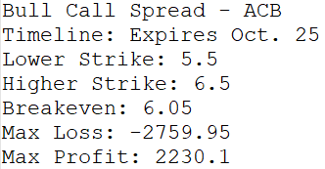
Current open positions
Worthless!

Slide 8
Objectives
What are our goals for this competition? What do we want out of it?
Are we aiming for 1st? How much are we willing to sacrifice for it? Top 10?
Notes:
-We are going to have to focus on holding options positions until expiry.

Slide 9

New Competition timeline?

Slide 10
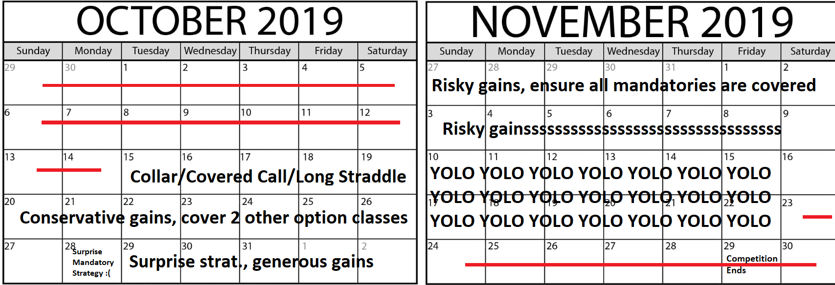
Competition timeline

Slide 11
New Competition timeline?

Slide 12
Final thoughts and Key Takeaways:
Let’s decide on some trades for this week. Risk level?
Future risk levels and goals:
[Enter decision here]
All meeting slides are now on Github. Pull that repo!
Good work on top 10; Keep it up, we still have a long way to go!
Notes:
Where should they be uploaded? Google drive? Facebook?

